Slide 1

DevOps Fix and Tech Stuff
Hamza Nasir

Slide 2
Agenda
Who Am I?
My Certfications
Why this channel?
What you’ll get here?

Slide 3
Who Am I?
7 Years Experience in IT and still learning
DevOps Engineer-II
Hands-on experience with AWS, CDK, Terraform, Github Actions, and Monitoring tools(Datadog)
Working daily in real-world production environments
Passionate about sharing practical knowledge
Not a Teacher – Just sharing what and how I do and help community

Slide 4
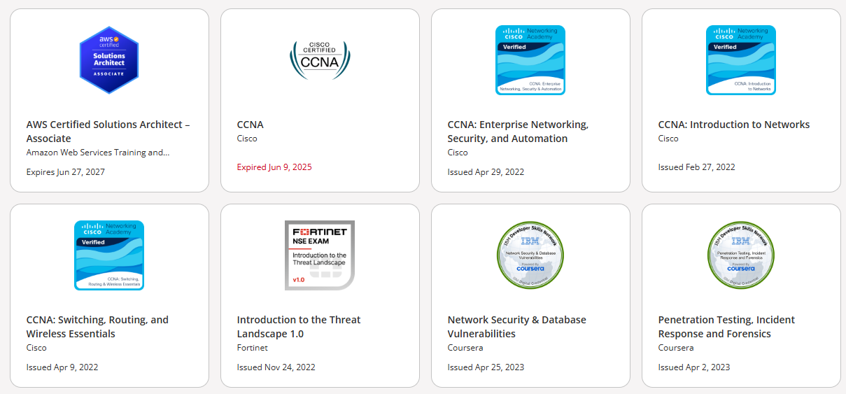
Certifications

Slide 5
Why this channel?
Learn Real world scenarios, Real problems and solutions
Simplified explanations for beginners to intermediate engineers
Focus on practical problem-solving, not just theory
Questions to your Queries
AWS or Tech stuff simplified
1
Problem
2
Research
3
Why this solution
4
Implementation
5

Slide 6

What you’ll get here
DevOps Scenarios/automation
Workflows (AWS, CDK, Gtihub Actions, ECS, migration to EKS, etc)
Real world debugging and troubleshooting session
Short, easy-to-digest videos
Other tech stuff that I feel needed to be share
6

Slide 7
Why subscribe?
Actual scenarios from real DevOps work.
Quick, actionable insights you can apply immediately.
Learn skills that recruiters and companies are actively hiring for.
7

Slide 8
Let’s Begin
Subscribe for real-world DevOps learning
Comment if there is any specific topic that you’d like to see
Let’s grow together in tech!

